Slide 1
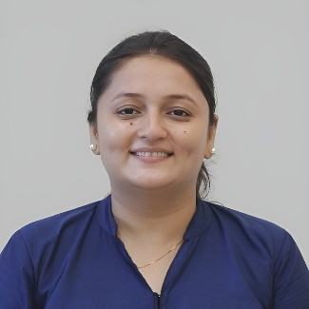
Informal to Formal
TCS Placement Practice
Prof. Radhika J Bhateliya
Humanities and Science Department
radhika.bhateliya@darshan.ac.in
9428035992

Slide 2

Looping
Topics
  Tips
  Practice

Slide 3
Informal to Formal
Notes:
Gif Reference: https://tenor.com/view/tkthpsharma-gif-23317246

Slide 4
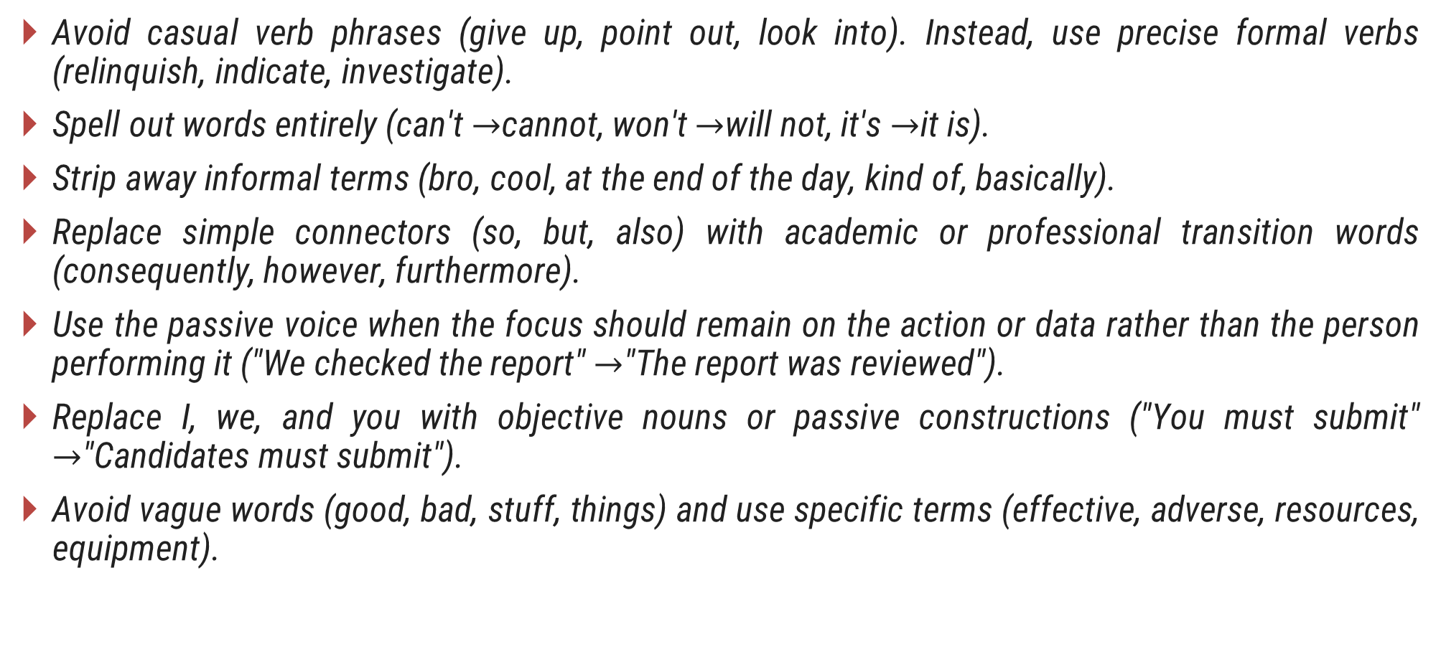
Tips
Avoid casual verb phrases (give up, point out, look into). Instead, use precise formal verbs (relinquish, indicate, investigate).
Spell out words entirely (can't $→$cannot, won't $→$will not, it's $→$it is).
Strip away informal terms (bro, cool, at the end of the day, kind of, basically).
Replace simple connectors (so, but, also) with academic or professional transition words (consequently, however, furthermore).
Use the passive voice when the focus should remain on the action or data rather than the person performing it ("We checked the report" $→$"The report was reviewed").
Replace I, we, and you with objective nouns or passive constructions ("You must submit" $→$"Candidates must submit").
Avoid vague words (good, bad, stuff, things) and use specific terms (effective, adverse, resources, equipment).

Slide 5
Practice
Informal: We need to talk about the budget right now.
  We must discuss the budget immediately.
  The team needs to address the financial plan without delay.
  It is imperative that we review the budget allocations forthwith.
Informal: I can't come to the meeting because I'm sick.
  I am unable to attend the meeting due to illness.
  Regrettably, I cannot attend the meeting owing to a medical condition.
  I must request an absence from the meeting on account of indisposition.
Informal: The dev team checked out the bug and fixed it.
  The development team investigated the defect and resolved it.
  The engineering team examined the software issue and rectified it.
  The technical team audited the system anomaly and implemented a resolution.

Slide 6
Practice
Informal: Shoot me an email when you get a chance.
  Please send me an email when convenient.
  Kindly forward your response via email at your earliest convenience.
  Please transmit the relevant information by email upon receipt]
Informal: That idea sounds really cool and might work.
  That proposal appears promising and viable.
  The suggested approach seems effective and feasible.
  The initiative demonstrates considerable potential and merit.
Informal: We ran out of money so we stopped the project.
  The project was halted due to a lack of funds.
  Depleted financial resources necessitated the suspension of the initiative.
  Owing to capital constraints, the enterprise was discontinued.

Slide 7
Practice
Informal: Thanks a lot for helping me with this stuff.
  Thank you for your assistance with these matters.
  I appreciate your support regarding these deliverables.
  I extend my sincere gratitude for your guidance on these operational tasks.
Informal: The manager told us to cut down on costs.
  The manager instructed the team to reduce expenses.
  Leadership directed staff to curtail operational expenditures.
  Executive management mandated a strategic reduction in overhead.
Informal: Don't forget to double-check your work before sending it.
  Remember to review your work before submission.
  Employees should thoroughly proofread all deliverables prior to dispatch.
  Ensure meticulous verification of the documentation antecedent to transmission.

Slide 8
Practice
Informal: The sales went way up last quarter.
  Sales increased significantly last quarter.
  Revenue demonstrated a substantial rise during the previous quarter.
  Financial yields experienced a remarkable expansion in last quarter.
Informal: We're totally open to changing the plan if needed.
  We are open to modifying the plan if necessary.
  The team remains willing to adjust the framework as required.
  We maintain full flexibility to amend the operational strategy contingent upon circumstances.
Informal: He made a huge mistake in the financial report.
  He made a significant error in the financial report.
  An appreciable oversight occurred within the financial statement.
  A critical discrepancy was introduced into the fiscal audit.

Slide 9
Practice
Informal: Can you help me figure out this problem?
  Could you assist me in resolving this issue?
  Would you be able to aid in determining the root cause of this challenge?
  Please provide guidance to elucidate a solution for this operational issue.
Informal: The boss was super happy with our performance.
  The manager was pleased with our performance.
  Leadership expressed high satisfaction regarding our output.
  Executive management commended the team for outstanding performance.
Informal: It's totally fine if you send the file tomorrow.
  Submitting the file tomorrow is acceptable.
  It is permissible to deliver the documentation on the following day.
  Transmitting the requested file by the subsequent business day will suffice.

Slide 10
Practice
Informal: Lots of people think this new tech is great.
  Many professionals view this technology favourably.
  Numerous industry experts consider this innovation highly beneficial.
  Widespread consensus indicates that this technology offers substantial utility.
Informal: We'll get back to you ASAP.
  We will respond to you as soon as possible.
  Our team will contact you at the earliest convenience.
  A formal reply will be rendered expeditiously.
Informal: I'm writing this email to ask for a day off.
  I am writing to request a leave of absence.
  This correspondence serves as a formal request for one day of annual leave.
  I am submitting a formal application for a single-day personal leave.

Slide 11
Practice
Informal: The price was kind of expensive so we didn't buy it.
  The cost was high, so we opted not to purchase it.
  Due to elevated pricing, the acquisition was not pursued.
  Excessive expenditure rendered the procurement prohibitive.
Informal: We need to set up a quick call tomorrow.
  We need to schedule a short meeting tomorrow.
  A brief teleconference should be arranged for tomorrow.
  It is necessary to convene a concise consultation on the subsequent date.
Informal: The app crashed because of a weird error.
  The application failed due to an unexpected error.
  System instability resulted from an unidentified software anomaly.
  The platform experienced a system collapse attributed to an unprecedented error code.

Slide 12
Practice
Informal: You should check out their new website.
  You are encouraged to visit their new website.
  Stakeholders are advised to review their updated online portal.
  It is recommended to inspect their newly launched digital interface.
Informal: The company is getting bigger really fast.
  The company is expanding rapidly.
  The organization is undergoing swift growth.
  The enterprise is experiencing accelerated market expansion.
Informal: We haven't got the approval yet.
  We have not received approval yet.
  Formal authorization has not been granted to date.
  Official sign-off remains pending.

Slide 13
Practice
Informal: That bad decision messed up the whole schedule.
  That poor decision disrupted the entire timeline.
  The ill-advised choice compromised the project schedule.
  An erroneous decision severely impaired the overarching project milestones.
Informal: I'll look into this matter right away.
  I will investigate this matter immediately.
  I shall examine this issue without delay.
  I commit to conducting an immediate inquiry regarding this situation.
Informal: They don't allow anyone to bring food inside.
  Food is prohibited inside the premises.
  External sustenance is strictly forbidden within the facility.
  Bringing food into the venue is expressly disallowed per safety guidelines.

Slide 14
Practice
Informal: The client wants us to redo the whole presentation.
  The client requested that we revise the entire presentation.
  The client has mandated a complete overhaul of the presentation materials.
  The client requires a comprehensive restructuring of the slide deck.
Informal: We're short on staff this week.
  We are currently understaffed this week.
  The organization is experiencing a temporary workforce shortage this week.
  Human resource capacity is constrained during the current operational cycle.
Informal: He gave up his job to start his own business.
  He resigned from his position to launch a business.
  He relinquished his employment to pursue an entrepreneurial venture.
  He tendered his resignation in order to establish an independent commercial enterprise.

Slide 15
Practice
Informal: Make sure you lock the server room when you leave.
  Please ensure the server room is locked upon departure.
  Personnel must secure the server facility when exiting.
  It is mandatory to engage the lock mechanism on the server room door upon departure.
Informal: We can't do anything about this problem now.
  We cannot address this issue at present.
  No immediate measures can be taken regarding this matter.
  Circumstances preclude any actionable intervention on this issue currently.
Informal: The training session was super boring.
  The training session was unengaging.
  The instructional seminar lacked interactive substance.
  The training program proved unstimulating and repetitive.

Slide 16
Practice
Informal: Send us the documents by Friday at the latest.
  Please submit the documents no later than Friday.
  All requested files must be tendered by Friday close of business.
  Documentation must be submitted antecedent to the Friday deadline.
Informal: I think this strategy is a bad idea.
  I believe this strategy is inadvisable.
  In my assessment, this strategic approach carries significant drawbacks.
  I hold the view that this strategic framework is fundamentally flawed.
Informal: We got a lot of complaints from angry customers.
  We received numerous complaints from dissatisfied customers.
  The firm registered a substantial volume of grievances from clients.
  A high frequency of formal complaints was logged by aggrieved patrons.

Slide 17
Practice
Informal: The meeting went on for way too long.
  The meeting exceeded its scheduled duration.
  The conference extended significantly beyond the allocated timeframe.
  The proceeding was unduly prolonged past its intended conclusion.
Informal: Call them up and find out what happened.
  Contact them to inquire about the situation.
  Contact the relevant parties to ascertain the details.
  Communicate with the stakeholders to determine the precise sequence of events.
Informal: This tool makes our work a whole lot easier.
  This tool significantly simplifies our work.
  This utility greatly enhances operational efficiency.
  Implementation of this software greatly facilitates daily workflow output.

Slide 18
Thank You

